Slide 1
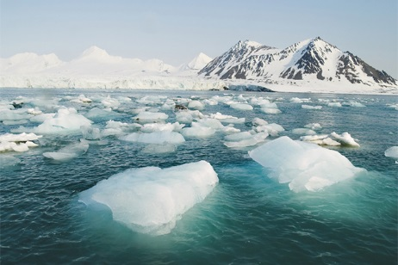
Tourists Threaten the Arctic

Slide 2
Tourists love taking cruises into the arctic
Beautiful place to travel to

Slide 8
In November 2007, the M/S Explorer was traveling through ice near Antarctica
Suddenly, it hit an iceberg

Slide 10
Water began pouring in and passengers raced from their cabins

Slide 11
All 154 people scrambled onto life boats to escape the sinking ship
They were pulled to safety by two cruise ships sailing nearby

Slide 12
People were very luck
There are no cities, hospitals or rescuers nearby in Antarctica

Slide 16
Expedition boom in 1969 with ships that carry hundreds of people
One of them carried 3800 people ready top explore Antarctica

Slide 17
Many ships burn cheap fuel to save costs
This in turn affects the environment
Pollutes the air and harms the habitats in that environment

Slide 18
People are climbing into penguin habitats and disturbing their colonies just to get the perfect picture

Slide 19
Many are trampling moss beds which take centuries to grow a few inches
People sometimes bring in invasive species which have hitchhiked on their boots, clothes and backpacks

Slide 20
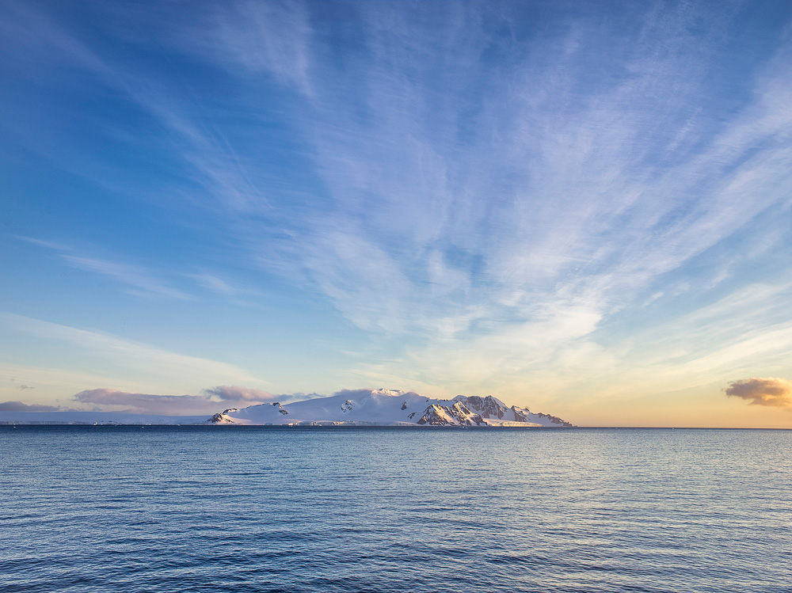
How do tourists threaten the habitats in Antarctica? Explain and provide examples.
What are the benefits of tourism in Antarctica?
What are the drawbacks of keeping Antarctica as a popular tourism spot for people around the world?

